Slide 1
CSC312
Automata Theory
Lecture # 7
Chapter # 5 by Cohen (Cont…)
Finite Automata

Slide 2









Transition Diagram
abba -Finite Accepter
initial
state
final
state
“accept”
transition
state

Slide 3
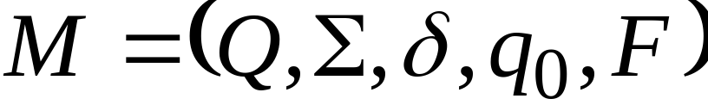




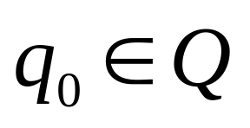
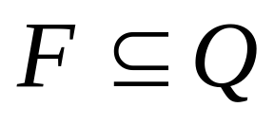

Formalities
Deterministic Finite Accepter (DFA) OR Deterministic Finite Automaton
: set of states
: input alphabet
: transition function
: initial state
: set of final states

Slide 4

Input Alphabet

Slide 5
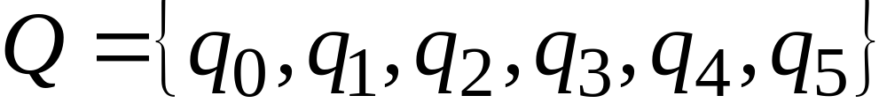
Set of States

Slide 6
Initial State

Slide 7
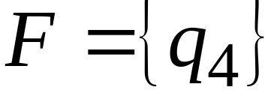
Set of Final States

Slide 8
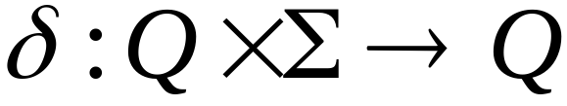
Transition Function

Slide 9
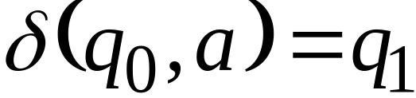

Slide 10
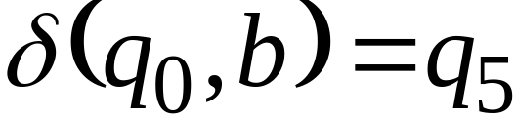

Slide 11
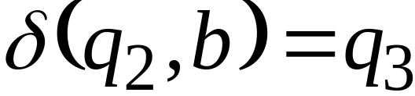

Slide 12


Transition Function

Slide 13
Ex: The FA that accepts the language with RE = (a+b)*(aa+bb)(a+b)*
Ex: The FA that accepts the language with all the strings having at least one triple letter.
Ex: The FA that accepts the language of all the words that
Have b as the 2nd letter
Have b as the 3rd letter

Slide 14
Note: there are FAs that accept no language. These are of two types
FA’s that have no final state, such as
(ii) FA’s in which final states cannot be reached from the start state i.e. a disconnected graph or graph like this

Slide 15
See examples on page 58, 60, 62, 63, 64, 65, 66, 67, 68, 69, 70
Ch # 5 Exercise p-71
Questions: 1, 2, 3, 4, 5, 6, 7, 8, 9

